Slide 1
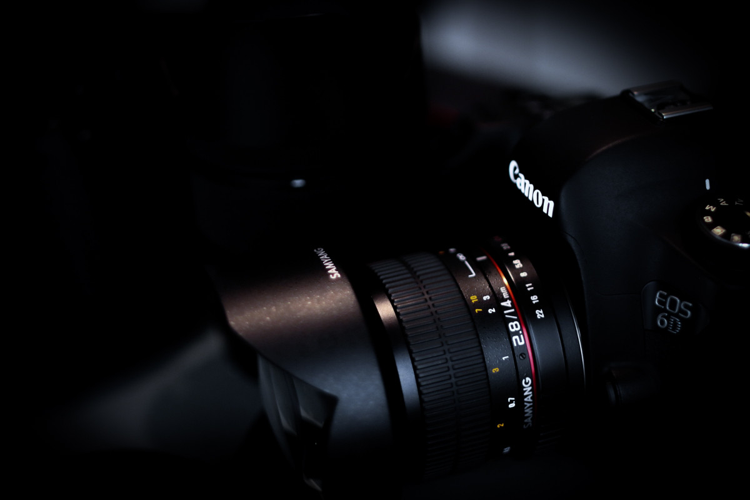
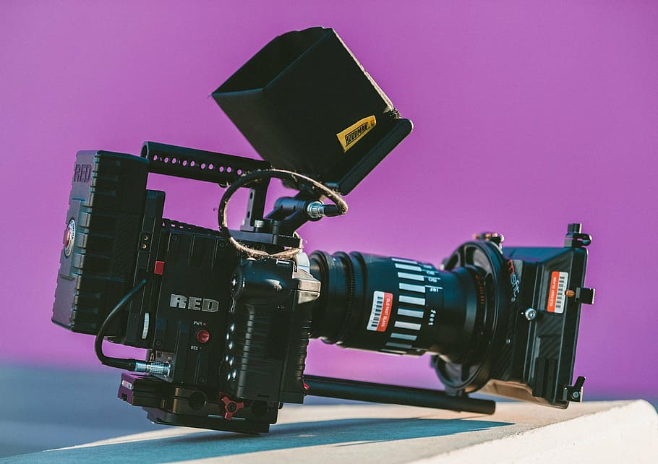
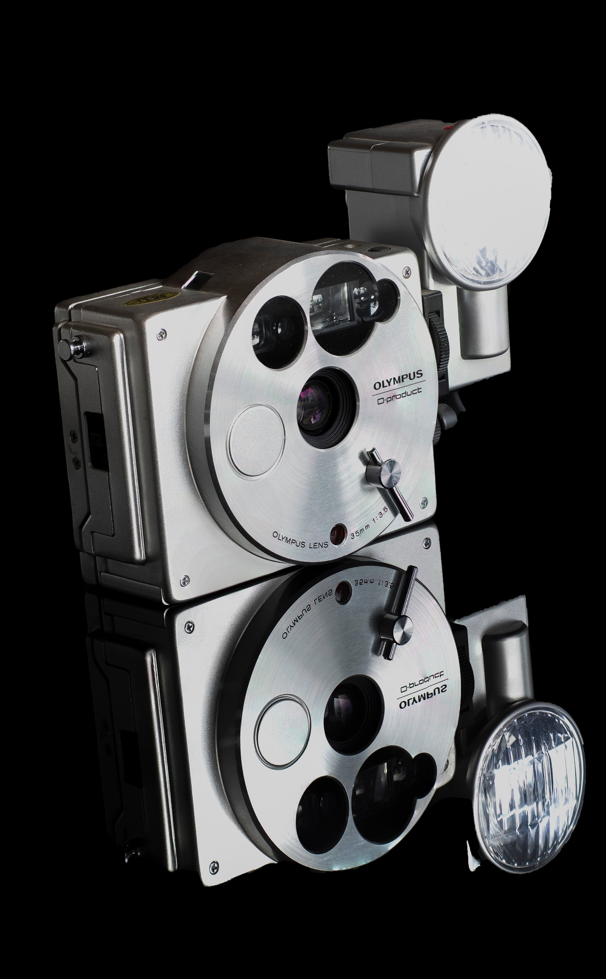
APP PHYSICS 167
APPLIED OPTICS
HOLOGRAPHY
FOURIER TRANSFORM PROPERTY OF LENSES
NINO PHILIP RAMONES | GITHUB
2020 – 05616
JANUARY 13, 2024

Slide 2
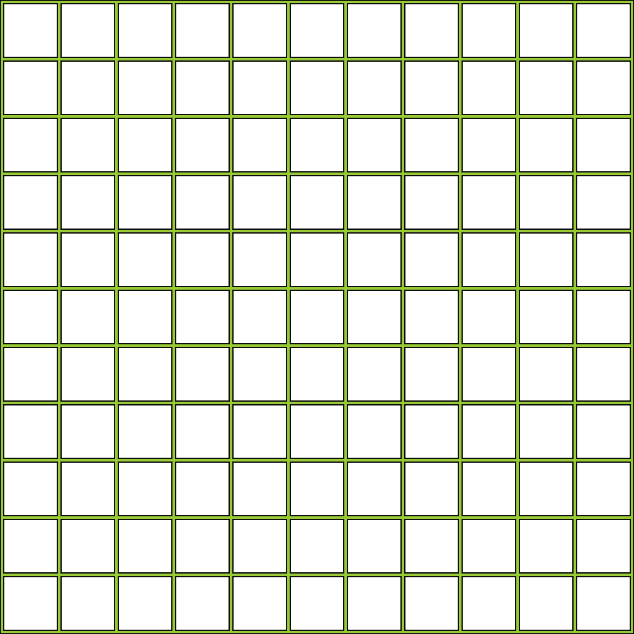
APP PHYSICS 167
HOLOGRAPHY
OBJECTIVES
Understand how digital holography works and forms from the interference of two monochromatic beams
Extract the phase and amplitude information of a light
KEY TAKEAWAYS
Holography uses the principle of interference between two coherent monochromatic beams emanating from the reference object and the beam that passes through it
This technique can be used to extract and record both the amplitude and phase of light that passes through an object through image analysis

Slide 3
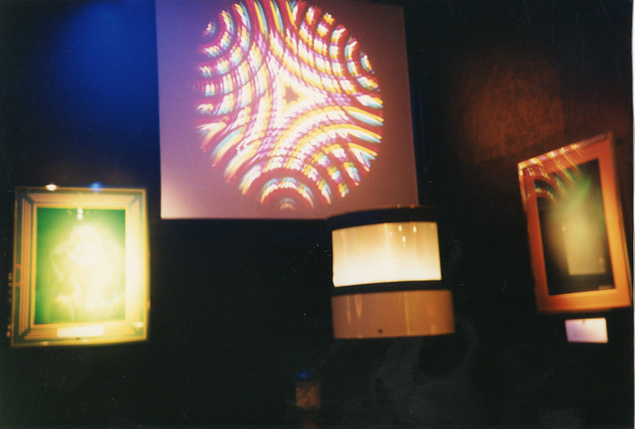
APP PHYSICS 167
HOLOGRAPHY
HOLOGRAPHY
Figure 1. A sample hologram projection. This Photo by Unknown Author is licensed under CC BY-SA.
Holography primarily relies on interference patterns to produce images that can offer a potential to contain a field information, i.e. amplitude and phase. In comparison to the standard photographs that only records intensity, holograms offer much more potential in characterizing an object as it offers depth information while also being close to the resemblance of an object. In digital holography, holograms are usually recorded by a charged-couple device (CCD) and reconstructed by numerical methods such as the Fresnel transform and convolution.

Slide 4
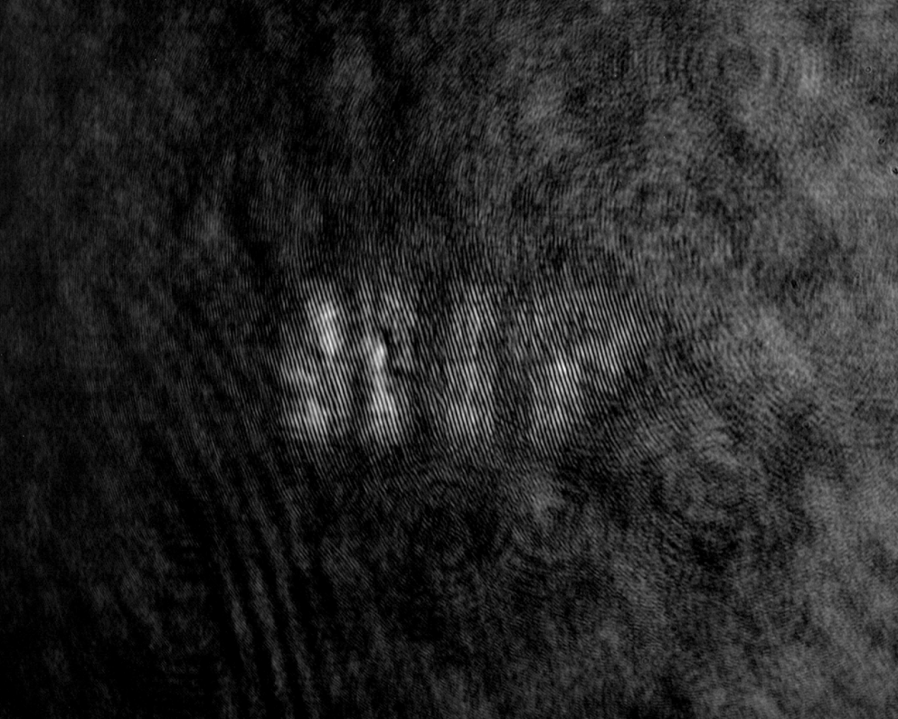
APP PHYSICS 167
HOLOGRAPHY
METHODS
Figure 2. Experimental hologram used in the activity
The scheme for the hologram reconstruction starts with the removal of the zero-order diffraction or DC component by passing the hologram through a high-pass filter by Fast Fourier transform. Th resulting spectrum is then center-shifted to remove the carrier frequency and twin image. To demonstrate the numerical focusing on the amplitude and phase, we intend to vary the observation distances in our coding algorithm as shown in the results.

Slide 5
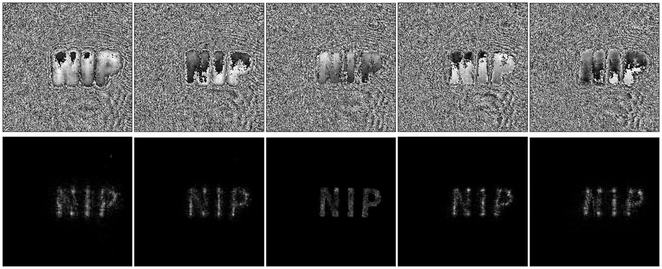
APP PHYSICS 167
HOLOGRAPHY
RECONSTRUCTIONS
Figure 3. Phase (top row) and the corresponding amplitudes (bottom row) for a holographic reconstruction at different observation distances. From left to right, the distance is at 0.05 mm at increments of 0.03 mm
Figure 3 illustrates the focusing of the holographic reconstruction as the observation distance increases. For smaller distances, the image obtained was observed to be blurred and scattered, which then becomes more distinguished as the distance approaches around 0.11 mm, then becomes blurred again at the next distance values.

Slide 6
APP PHYSICS 167
HOLOGRAPHY
REFLECTION
I find the activity fun since I was able to visualize different the field information of an actual digital hologram. I was able to experience the simple feel of working on the image processing of a digital hologram. I will give myself a grade of 92 / 100 for accomplishing the objectives of the activity. I think I could have done more and better in the activity by varying the other parameters such as the filters and reconstruction wavelengths and investigate its effect on the reconstruction of the hologram itself.
REFERENCES | GITHUB
M. Soriano, Applied Physics 167 – Digital Holography

